Slide 1
Processing electronic records
Handling removable and fixed media in manuscript collections
Meghan Bannon, Center for the History of Medicine, Harvard Medical School
New England Archivists Spring 2014 Meeting
Notes:
Hello, my name is Meghan Bannon, and I am a Project Archivist at the Center for the History of Medicine at Harvard Medical School. I will be presenting today about the Center’s approach to processing electronic records, including how the Center developed a workflow that met our current needs, the tools we utilize, and how are policies continue to be a work in progress. I will be primarily focusing on removable and fixed media, rather than discussing the acquisition of email and other types of born digital records that I tend not handle on a regular basis.

Slide 2
Types of E-Media in the Center’s Manuscript Collections
3.5” floppy disks
5.25” floppy disks
Zip disks
Thumb drives
CDs
DVDs
Hard drives
Notes:
I want to begin by describing how the Center handled electronic records prior to adopting a more formal workflow. I started at the Center as an intern during graduate school, eventually holding part-time positions where I would perform traditional processing tasks on manuscript collections, such as folder listing, refoldering, and some preservation tasks. At this point, though, the majority of the collections I processed dated from the 1920s-1960s, so it was rare that I had to deal with electronic media. If I did come across any, I would just place a paper flag in the folder, make a note in the Excel folder list, and just move on.
The Center also didn’t have the necessary technology and tools to handle electronic media found in collections. We had an external 3.5” floppy disk drive and an external Zip disk drive, but we needed to conduct more research into best practices before we started incorporate these drives into our processing workflow.
It wasn’t until 2012, when I became the Project Archivist for the William A. Haseltine papers and M. Judah Folkman papers, that processing removable and fixed media became routine, just like folder listing and refoldering. I had no experience processing electronic records prior to 2012, so everything over the last two years has been really a complete learning experience for me.
When I started my project position, the Center was working on developing electronic records accessioning and processing policies. More and more of the collections we received contained records from the 1980s to the present day. Prospective donors were also beginning to ask questions—they wanted to know how their email was going to be saved, what would happen to their donated computer hard drive, and so on.
In Haseltine’s and Folkman’s collections, there contained over 130 individual pieces of electronic media, which consisted of:
-Different types of floppy disks
-Zip disks
-Thumbs drives
-CDs and DVDs, and
-1 hard drive

Slide 3
E-Media Log
Creator | Folkman, M. Judah
Title | M. Judah Folkman papers, 1954-2008 (inclusive) (H MS c365)
Size (GB) | 0.01
852__$$h_Class_Part | ACC. 2011-133
MSS or ARCH | m
Box | 13
Folder | 19
Storage Type | External
Media | 3.5 Floppy Disk
CHoM e-media identifier | 266
E-Media labeled? Y/N | Y
Notes | Imaged/Extracted
Notes:
Center staff began to meet to test out the various tools other institutions were using to accession and process e-media, as well as enroll in courses offered by SAA, including Digital Forensics for Archivists. While we were figuring out what tools we needed, Emily Gustainis, the Center’s Head of Collection Services, developed a system where we would physically label any e-media we came across while processing with a unique identifier and then log its’ descriptive information in an Access database.
Here are several of the fields taken from an entry from Folkman’s collection:
-Creator
-Title
-Size (GB): Total size of the media in gigabytes – this is determined by just using the manufacturing information found right on the media
-852__$$h: For the 852 field we put the accession number – this is important when your logging media at the point of accessioning, rather than during processing – you might use the 852 field for something different, but in cataloging system we put the accession number
-MSS or Arch: Whether or not it’s from a manuscript or archival collection
-Box
-Folder
-Storage Type: Is the media being logged an external drive or from network storage?
-Media: For media you put the format—in this example, from Folkman’s collection, it was a 3.5” floppy disk.
-CHoM E-Media identifier: This is the unique identifier we assigned
-Labeled?: Has the media been physically labeled, yes or no
-Notes: In the Notes field the processor would put any information that they thought was important for processing—was the disk rusty, did the folder also contain several other 3.5” floppy disks
By logging the media, we had an idea of what was in our holdings while we formulated our e-media policies and workflow.

Slide 4
Disk Imaging: Tools
Notes:
The next step was to choose the tools we needed for creating disk images, which is the preservation or forensic copy of the e-media.
There were certain things that the tool definitely had to do, namely, it had to ensure the integrity of the data:
Meaning that the disk image had to be an exact copy of the original media, so the tool needed to be able to run checksums.

Slide 5
FTK Imager
Creates disk images
Creates a .txt file containing image metadata
-Who created the image
-Date and time
-Source data size
-Errors
-MD5/SHA1 checksum
Creates .csv file containing file directory
Extracts files
Other Imaging Tools
Guymager,
Tableau Imager
EnCase Forensic Imager
Notes:
In the end, we chose Forensic Toolkit Imager, or FTK Imager, which is computer forensics software developed by AccessData.
FTK comes in two versions, the free Imager version, or, the full FTK version, which is more robust because it has keyword searching capabilities, as well as the ability to preview files in proprietary formats. We decided to stick with the free FTK Imager, or as we tend to call it, simply FTK.
Both versions of FTK create disk images, runs checksums, and log the metadata associated with each image in a text file.
The text file will log:
-Who created the image
-Date and time the image was created
-The source data size
-Any errors that occurred during imaging, and the
-MD5 and SHA1 checksum verification
FTK can also export into an Excel or CSV [comma separate values] file the file directory of the imaged media.
There are several other disk imaging programs available besides FTK, including Guymager, Tableau Imager, and EnCase Forensic Imager, it’s just important to pick one that works for you.

Slide 6
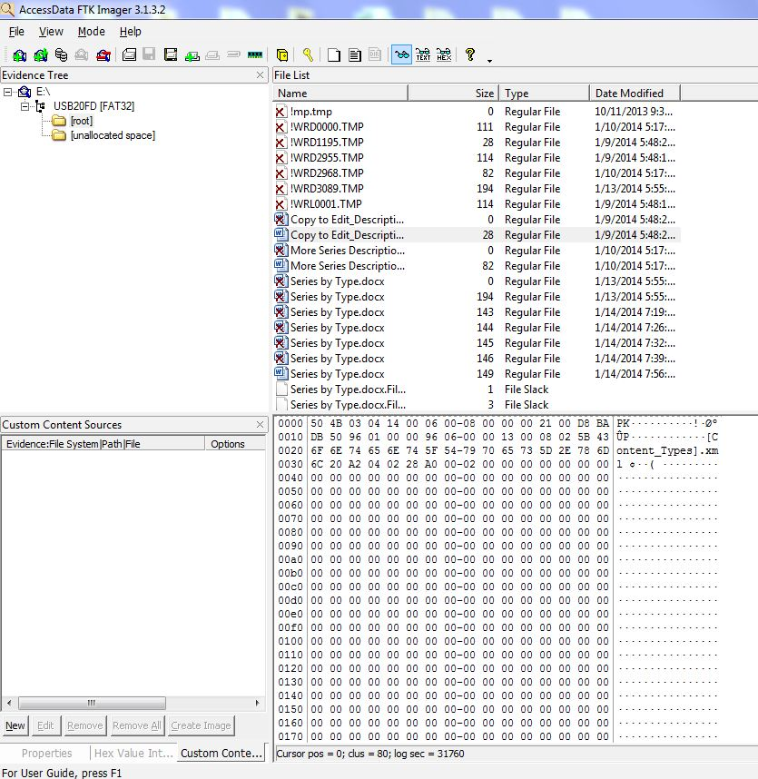
FTK Imager with a USB drive opened in the Evidence Tree
Notes:
This is a screenshot of my USB flash drive opened in FTK and what you would see before you created the disk image. The Evidence Tree to the upper left displays the drive’s file directory and when you click the [Root] folder, all of the files in that folder appear in the File List pane. As you can see, it also lists files I deleted.
The Preview Pane below the folder list displays the contents of a selected file. Unfortunately, since we’re using the free version of FTK, you can’t actually preview the Word document in FTK. So when this happens, I use QuickView [Plus 13 Standard]. QuickView can open files created in older versions of software, including word processing files, spreadsheets, databases, and presentations. And this goes for both Windows and Mac formats.
I won’t go into the step-by-step instructions of how to image and extract files using FTK, but if you are interested, there’s a user manual available through AccessData’s website.

Slide 7
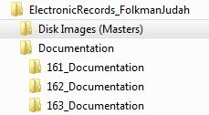
Example from the M. Judah Folkman Collection
Subfolders:
Three Folders Per Collection:
Notes:
As I mentioned earlier, FTK generates three files when it creates a disk image: the image itself, a text file, and an Excel or CSV file. At the Center, we setup a folder structure on our server to keep track of these various files.
We initially create three folders per collection:
Disk Images (Masters) – where we save the image file
Documentation – where we save the text and Excel file, and a folder for the
Extracted Use Copies for Processing – this is where we export, using FTK, the files extracted from the image. These are the copies of the files that we survey for description.
--Creating use copies means we don’t have to worry about altering the files while conducting the survey
And for the Document and Use Copies folders, we label the folders according to that unique identifier.

Slide 8
Disk Imaging: Hardware
Notes:
Next I want to discuss the Center’s disk imaging hardware. When choosing hardware, it was absolutely necessary that it had write-blocking capability, meaning that while previewing the drives and during imaging, the drive contents could only be viewed and not altered. You do not want to risk changing the last access or modified date of a file.
There are some media formats where you can physically turn on the write protect, such as floppy disks, but that’s not the case for all media.
Since we already had the external floppy and Zip drives, we needed the hardware and accessories to image other e-media, such as:
-Media cards
-Flash drives, and
-External hard drives

Slide 9
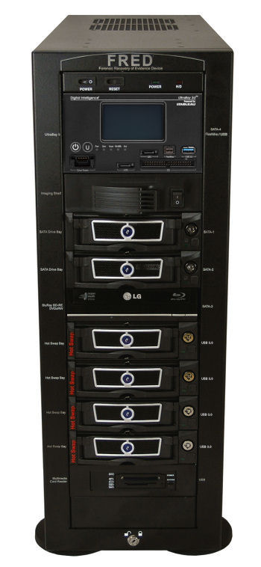
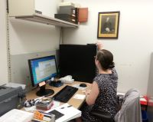
FRED (Forensic Recovery of Evidence Device)
Acquires data directly from various hard drives and storage devices:
IDE
SATA
SAS
FireWire
USB
CD-ROM
DVD-ROM
Thumb drives
Multimedia Cards Image from www.digitalintelligence.com
Notes:
Fortunately, the Center was able to purchase a FRED, or Forensic Recovery of Evidence Device, from Digital Intelligence in July 2013. The FRED workstation can acquire data directly from various drives with write block protection.
The FRED can pull data from numerous drives, IDE, SATA, SAS, and so on.
It also has multiple bays where you can store external hard drives to be used for saving image backups.
The FRED is an expensive piece of hardware that provides faster processing and allows for the imaging of multiple removable e-media at once, but you definitely do not need a FRED for imaging or extracting.

Slide 10
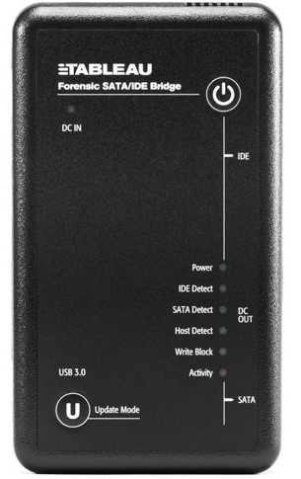
Tableau Forensic Bridge
From Guidance Software
Write-block protection in the field
Offers the same features as the FRED
write-blocker
Connects to computer via USB 3.0
Image from www.guidancesoftware.com
Notes:
One of the less expensive pieces of hardware available is the Tableau Forensic Bridge from Guidance Software. The bridge is a write blocker that comes in several versions and it provides the same write-block protection as the FRED, just in a mobile form.
We predominately use to acquire e-media from donors at the point of accession. The bridge is strictly a write-blocker, so when we are imaging in the field, we also bring with us a 1TB external hard drive to save the images.

Slide 11
Describing Electronic Media in Finding Aids
Notes:
Now that we had the imaging and extracting process worked out, we had to decide how to describe the e-media in our finding aids.
-At what levels of description should we describe the media contents?
-Were we going to add a gigabyte extent like you do with cubic feet? And,
-How should we describe access and use restrictions?
But before we could answer any of these questions, we needed to conduct a survey of the media contents:
As a policy, we don’t open every extracted file or print out . Instead we sample several files to get an idea of the contents. If there are files in multiple formats, we sample files from each format. Even if you don’t open every file, you can still get descriptive information by looking at the file’s properties. But it is important to keep in mind that after Windows XP, the last access date feature was turned off—so, unlike previous versions of Windows, the last time someone accessed a file is no longer logged.
Since we don’t review every file, we don’t know if the files contain any access restrictions. If a patron wants access to the e-media contents, they are asked to contact Public Services, who will then review the files to determine if there are any patient or student records, as well as any University records.
The Center is still working on the best method for supplying patron access to imaged media. One option discussed would be to bring an external hard drive to the reading room containing the requested files. It is going to take some time to develop the appropriate approach, but it’s definitely a priority.

Slide 12
Quantity:
92.6 cubic feet (95 records center cartons, 3 oversize flat storage boxes, and flat file storage cabinet). 14.4 gigabytes of electronic records (71 compact discs, 27 3.5 inch floppy disks, 5 USB flash drives, and 1 Zip disk).
Processing Information:
Files on 3.5 inch floppy disks, compact discs, Zip disks, and USB flash drives were imaged using Forensic Toolkit Imager. Files were then extracted, surveyed and transferred to secure storage.
Notes:
So here are a couple of examples of how I described e-media in Judah Folkman’s finding aid:
For Quantity: The gigabyte extent and e-media formats were included along with the cubic feet extent and box types.
For Collection Level Processing Information: Several sentences were added to the Center’s standard processing statement to include electronic records. The wording will vary depending on the formats found in the collection.
We have also have developed two different methods when to comes to how we physically process and intellectually arrange e-media in a manuscript collection.
A.) If all the files on the e-media are the same, we integrate the media as if it were a folder within the series. For example:
*If a CD only contains presentations, we would list and describe the CD as part of an existing series (say Lectures and Presentations, or Professional Activities)
B.) BUT, if the CD contains a variety of record types that could map to multiple series:
*We would not do file level mapping, but rather create an Electronic Records series and in the series descriptions refer people to the e-records series for additional records. That’s why it’s important to provide a good folder level scope and content note for each piece of media.

Slide 13
Collection and Series Level Access Restrictions:
Access to electronic records in this collection (as found in Series II-V and VIII-IX) is premised on the availability of a computer station, requisite software, and/or the ability of Public Services staff to review and/or print out records of interest in advance of an on-site visit.
Folder Level Scope and Content Notes:
11. Lectures and Manuscripts and PowerPoint, 2003-2004
Scope and Content: Surveyed files include PowerPoint presentations about angiogenesis inhibitors, endostatin, and thrombospondin-1, as well as correspondence, photographs of patients, and Folkman’s reviews of submitted journal manuscripts. Center for the History of Medicine electronic media identifier 243.
Notes:
For Collection and Series Level Access Restrictions: A sentence was added to our standard access restrictions statement about needing the requisite software and time to review the records.
And finally, for Folder Level Scope and Content Notes: I provided here a brief overview of the record formats, file contents, and major subjects. This is all information I gathered during the brief survey of the extracted files. The unique identifier is also included so that Public Services has an additional point of reference when a patron asks for an individual piece of media.
The language the Center uses to describe e-media in our finding aids evolves as our workflow becomes more concrete, so some of my earlier finding aids has been worded differently.

Slide 14
Points to Remember
1. Even if you’re not ready to fully engage in an e-media processing program, at a minimum, try to keep track of e-media in your holdings
2. Determine what software and hardware fits in your budget
Storage space
3. Ask other repositories who are already processing e-media about their workflow
4. Don’t expect the process to always go smoothly
5. Try to learn as much as possible about the technology involved in the imaging process
6. Keep your e-media practices standardized across your repository
Notes:
There are a lot more steps and details that go into disk imaging and file extraction, but this was just a brief overview of the Center’s process.
Our accessioning and processing policies for e-media is a constant work in progress. Center processing and records management staff meet regularly to go over any questions or problems encountered while disk imaging both in the field and while using the FRED workstation, so our workflow will probably added to and updated over time.
I wanted to end this presentation with some key points that really stood out to me while we developed, and continue to develop, e-media processing policies at the Center:
First--
Even if you’re not ready to start processing e-media, logging our e-media has been extremely useful—all of our data is in a shared database, giving staff the opportunity to see what types of media others are working with and what tools and hardware we might need in the future
Second, take a look at your budget. You don’t have to purchase a FRED or proprietary tools for disk imaging—there are numerous free tools out there that could be incorporated into your workflow
--Also, don’t forget about how you’re going to store all of these disk images
**Are they going to be stored on an external drive? On a server?
--Because a server is not a repository, if something becomes corrupted, it will get copied over and over again
Talk to others who have already gone through this process and see if they’d be willing to share their approach and what worked or didn’t work for them
No matter how many guides and instructions you develop, it won’t always go smoothly—a hard drive might fail during imaging, you won’t be able to open files, the media you are imaging has a virus, etc. –it takes time to work things out
Learning the technology is important. Just following a step by step manual while imaging doesn’t help you when you need to troubleshoot a problem during imaging—it’s important to know how and why the technology works.
Lastly, processors and records managers should both understand and follow the same guidelines. As I mentioned, all e-media policies were developed with the input of both Center processors and records managers
--Even if the processor will never go to a university department to image media, it is still important that they understand the process, especially if as time progresses and you decide to image and extract all e-media at the point of accession
--In that case, the processor will only be working with the extracted files and might not fully understand the process.
So I hope this presentation was helpful, and please feel free to email me if you have any questions. Thank you so much for your time.

